Slide 1




Bootstrap 4
Data Visualization
Data Visualization with
Bootstrap 4
SoftUni Team
Technical Trainers
Software University
http://softuni.bg

Slide 2


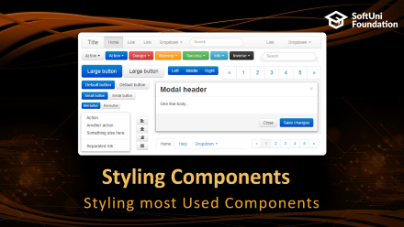





Table of Contents

Slide 3
Have a Question?
sli.do #Csharp-Web

Slide 4
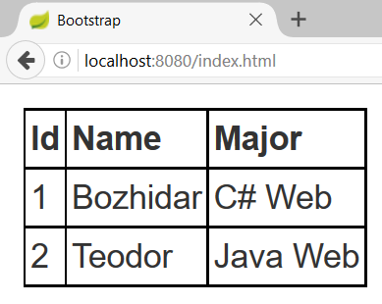
HTML Table
index.html
index.css
<table>
<tr>
<th>Id</th>
<th>Name</th>
<th>Major</th>
</tr>
<tr>
<td>1</td>
<td>Bozhidar</td>
<td>C# Web</td>
</tr>
…
</table>
table {
margin: 10px;
}
table, th, td {
border: 1px
solid
black;
border-collapse: collapse;
padding: 2px;
}
Table row
Table header
Table data

Slide 5

What is Bootstrap?
Responsive Web Design

Slide 6
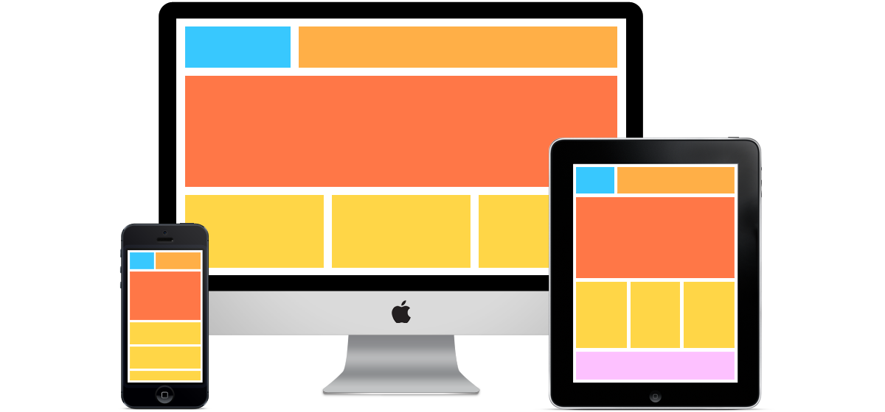
What is a Responsive Design?
Presentation layers that adjust according to the screen size of the different devices
Desktop layouts
Tablet layouts
Mobile layouts

Slide 7
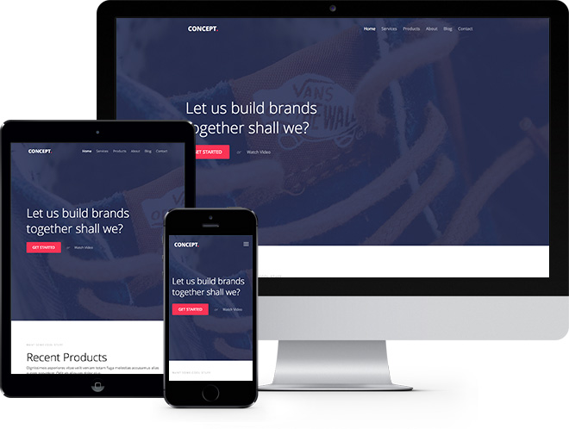
Bootstrap
Free front-end framework that provides capabilities to ensure responsive design

Slide 8

How to Import Bootstrap?
Import Options

Slide 9
Include from a CDN – CSS File
Include the Bootstrap CSS file before any other CSS file in your project
<link rel="stylesheet" href="https://maxcdn.bootstrapcdn.com/bootstrap/4.0.0-beta/css/bootstrap.min.css"/>

Slide 10
Include from a CDN – .js Files
Be sure to place jQuery and Tether first, as the Bootsrtap code depends on them
<script src="https://code.jquery.com/jquery-3.1.1.slim.min.js"/>
<script src="https://cdnjs.cloudflare.com/ajax/libs/tether/1.4.0/js/tether.min.js"/>
<script src="https://maxcdn.bootstrapcdn.com/bootstrap/4.0.0-beta/js/bootstrap.min.js"/>

Slide 11
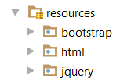
Download Resources
<link rel='stylesheet' href='../bootstrap/css/bootstrap.min.css'/>
<script src="../jquery/jquery.3.2.1.min.js"></script>
<script src="../bootstrap/js/bootstrap.min.js"></script>

Slide 12
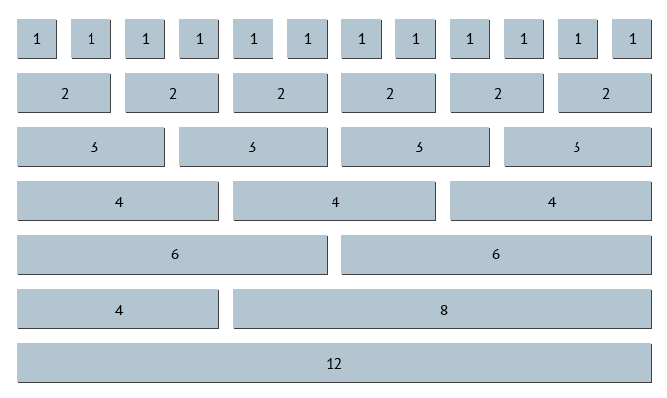
Grid System
Building Layouts

Slide 13
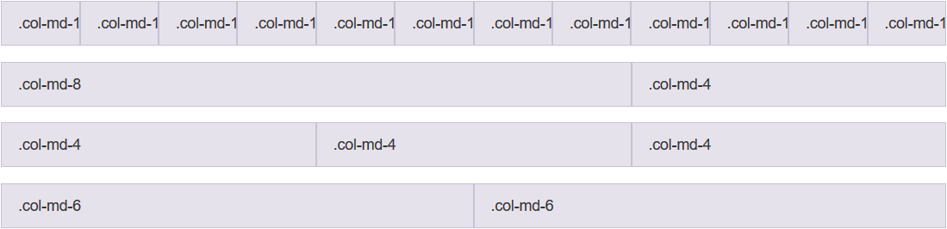
Grid System
Bootstrap includes a responsive, mobile first fluid grid system that appropriately scales up to 12 columns
Col 1
Col 2
Col 12
Row 1
Row 2
Row 3
Row 4

Slide 14
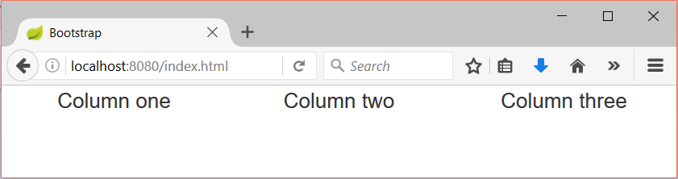
Grid System Demo
index.html
index.css
…
<div class="container-fluid">
<div class="row">
<div class="col-sm-4">Column one</div>
<div class="col-sm-4">Column two</div>
<div class="col-sm-4">Column three</div>
</div>
</div>
…
div {
text-align: center;
}
Container
Row
Columns

Slide 15
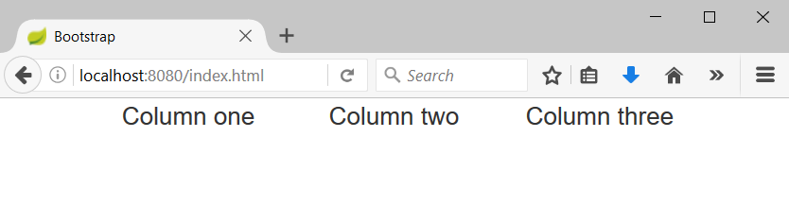
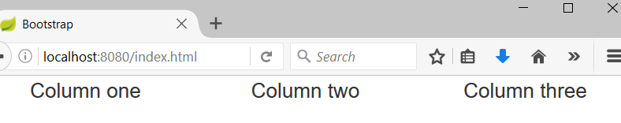
Containers
Rows must be placed in containers
.container is fixed-width
.container-fluid is full-width
Leaves margin
Full width, no margins

Slide 16
Column Classes
Determines how many columns to use on different screen sizes
.col-xs: Width Less than 768px
.col-sm: Width Between 768px and 992px
.col-md: Width Between 992px and 1200px
.col-lg: Width Over 120px
index.html
<div class="col-sm-8 col-lg-4">Column one</div>
<div class="col-sm-2 col-lg-4">Column two</div>
<div class="col-sm-2 col-lg-4">Column three</div>

Slide 17
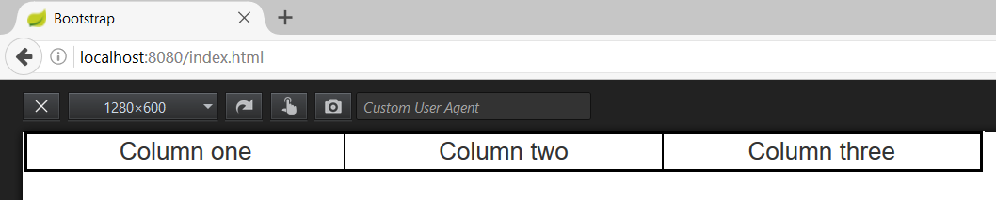
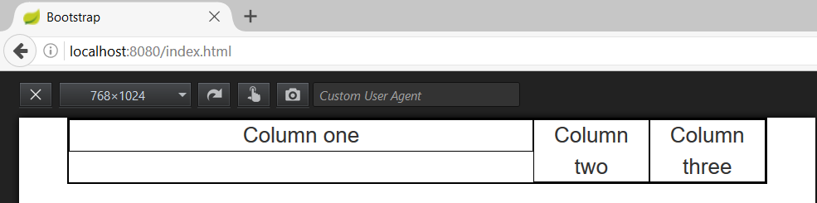
Column Classes (2)
index.html
<div class="col-sm-8 col-lg-4">Column one</div>
<div class="col-sm-2 col-lg-4">Column two</div>
<div class="col-sm-2 col-lg-4">Column three</div>
Width 1280px
Width 768px

Slide 18
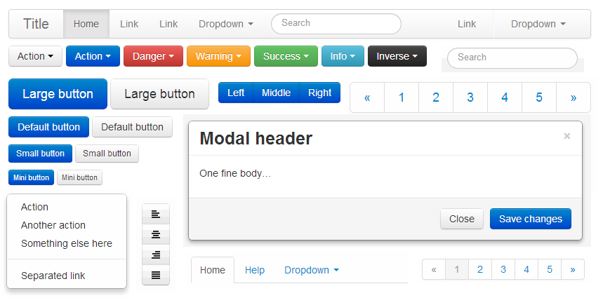
Styling Components
Styling most Used Components

Slide 19
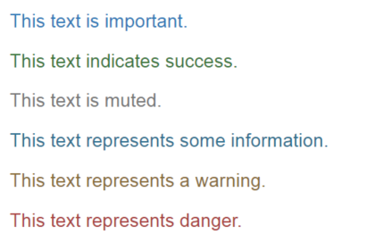
Typography with Bootstrap
Provide information about the role of the text
More on typography
More on text colors
index.html
<p class="text-primary">This text is important.</p>
<p class="text-success">This text indicates success.</p>
<p class="text-muted">This text is muted.</p>
<p class="text-info">This text represents some information.</p>
<p class="text-warning">This text represents a warning.</p>
<p class="text-danger">This text represents danger.</p>

Slide 20
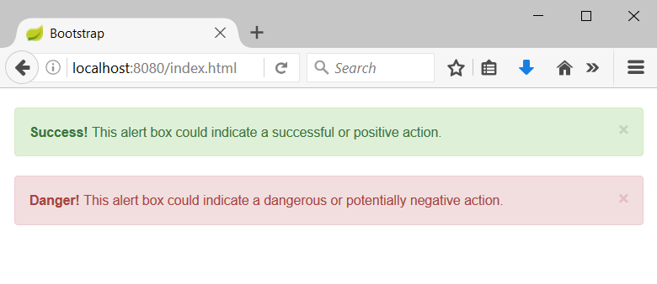
Alerts with Bootstrap
Provide information about the outcome of an event
index.html
<div class="alert alert-success alert-dismissable">
<a class="close" data-dismiss="alert" aria-label="close">×</a>
<strong>Success!</strong> This alert box could indicate a successful or positive action.
</div>
…

Slide 21
Buttons – coloring with Bootstrap
Provide information about the role of the button
index.html
<button type="button" class="btn btn-primary">Primary</button>
<button type="button" class="btn btn-secondary">Secondary</button>
<button type="button" class="btn btn-success">Success</button>
<button type="button" class="btn btn-info">Info</button>
<button type="button" class="btn btn-warning">Warning</button>
<button type="button" class="btn btn-danger">Danger</button>
<button type="button" class="btn btn-link">Link</button>

Slide 22
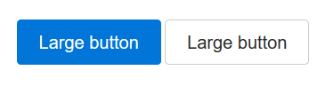
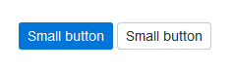
Buttons – sizing with Bootstrap
Provide information about the size of the button
More on buttons
index.html
<button type="button" class="btn btn-primary btn-lg">Large</button>
<button type="button" class="btn btn-secondary btn-lg">Large</button>
<button type="button" class="btn btn-primary btn-sm">Small</button>
<button type="button" class="btn secondary btn-sm">Large</button>

Slide 23

Icons with Bootstrap
Visualize a given icon from the standard bootstrap icons-sheet
If you want to use a different icon, simply change “glyphicon-cloud” to “glyphicon-{icon name}”
Bootstrap’s icons
index.html
<span class="glyphicon glyphicon-cloud"></span>

Slide 24
Nav and Navbar with Bootstrap
index.html
<div class="navbar navbar-default">
<div class="container-fluid">
<div class="navbar-header">
<a class="navbar-brand">Logo</a>
</div>
<ul class="nav navbar-nav">
<li class="active"><a href="…">Home</a></li>
<li><a href="…">About</a></li>
<li><a href="…">Contact us</a></li>
</ul>
</div>
</div>

Slide 25
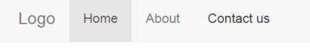
Nav and Navbar with Bootstrap(2)
The code from the previous slide shows the following:
There can be many ways to modify and position the navbar, so you may want to check out the other options

Slide 26
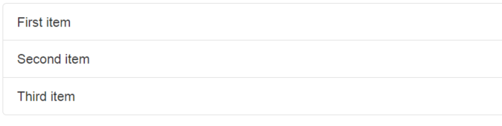
Lists with Bootstrap
Display a series of content
More on lists
index.html
<ul class="list-group">
<li class="list-group-item">First item</li>
<li class="list-group-item">Second item</li>
<li class="list-group-item">Third item</li>
</ul>

Slide 27
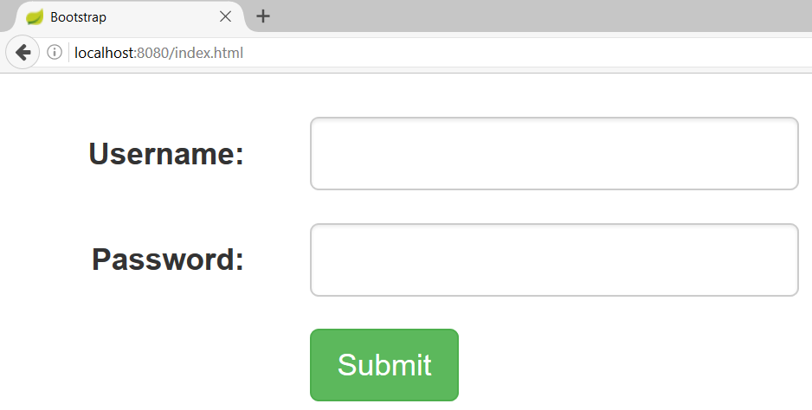
Forms with Bootstrap
index.html
<form>
<div class="form-group row">
<label class="form-control-label col-sm-2">Username:</label>
<div class="col-sm-4">
<input class="form-control" type="text"/>
</div>
</div> …
</form>

Slide 28
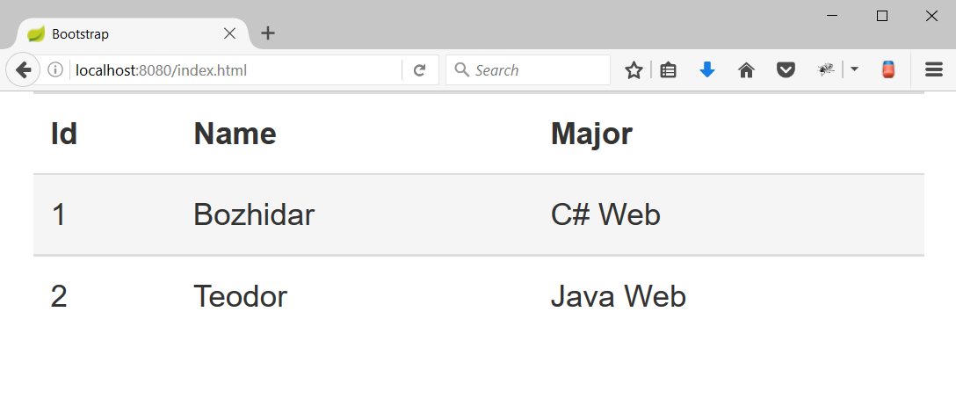
HTML Table with Bootstrap
Hover effect
index.html
<table class="table table-hover">
<tr>
<th>Id</th>
<th>Name</th>
<th>Major</th>
</tr>
<tr>
<td>1</td>
<td>Bozhidar</td>
<td>C# Web</td>
</tr>
…
</table>
Bootstrap table

Slide 29
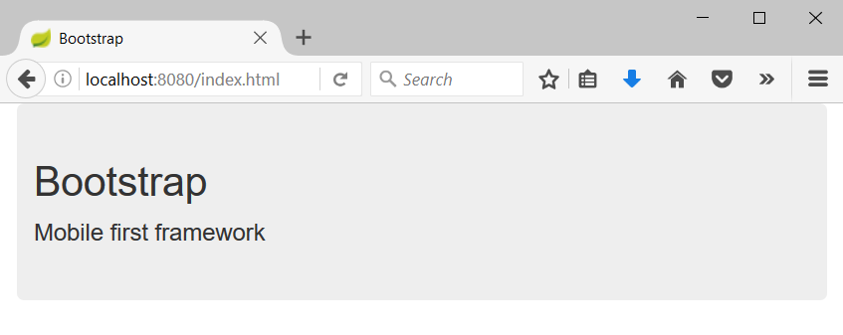
Jumbotron
Big box that provides information
index.html
<div class="container">
<div class="jumbotron">
<h1>Bootstrap</h1>
<p>Mobile first framework</p>
</div>
</div>

Slide 30

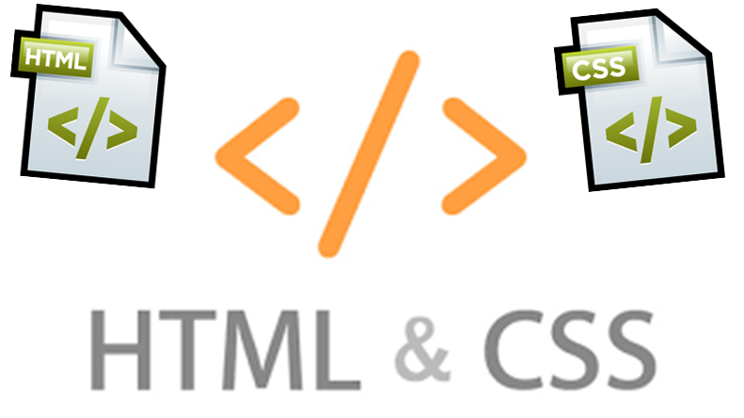
Summary
Bootstrap provides an easy way to create responsive design that fits on all screens
Cheatsheet to Bootstrap components

Slide 31







Web Development Basics – Bootstrap 4
https://softuni.bg/courses/csharp-web-development-basics

Slide 32

License
This course (slides, examples, demos, videos, homework, etc.) is licensed under the "Creative Commons Attribution-NonCommercial-ShareAlike 4.0 International" license

Slide 33





Trainings @ Software University (SoftUni)
Software University – High-Quality Education, Profession and Job for Software Developers
softuni.bg
Software University Foundation
http://softuni.foundation/
Software University @ Facebook
facebook.com/SoftwareUniversity
Software University Forums
forum.softuni.bg

